Slide 1
Fiber-Optic Cables
Prepared By: Er. Amit Kr tewari
Associate Professor
CS Dept.
ACEIT, Jaipur

Slide 2
Fiber-Optic Cables
A fiber-optic cable is thin glass or plastic cable that acts as a light “pipe.” It is not really a hollow tube carrying light, but a long, thin strand of glass or plastic fiber.
Fiber cables have a circular cross section with a diameter of only a fraction of an inch.
Some fiber-optic cables are the size of a human hair.
A light source is placed at the end of the fiber, and light passes through it and exits at the other end of the cable. How the light propagates through the fiber depends upon the laws of optics.

Slide 3
Principles of Fiber-Optic Cable
Fiber-optic cables operate on the optical principles of total internal reflection.
A beam of light is focused on the end of the cable. It can be positioned in a number of different ways so that the light enters the fiber at different angles.
For example, light ray A enters the cable perpendicular to the end surface.
Therefore, the light beam travels straight down the fiber and exits at the other end. This is the most desirable condition.

Slide 4
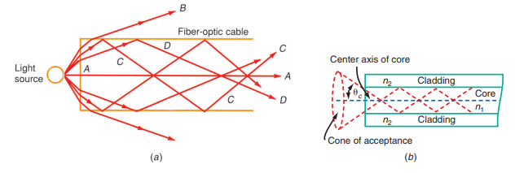
Principles of Fiber-Optic Cable

Slide 5
Principles of Fiber-Optic Cable
The angle of light beam B is such that its angle of incidence is less than the critical angle, and therefore refraction takes place.
The angle of incidence of light beams C and D is greater than the critical angle.
Therefore, total internal reflection takes place, and the light beams are reflected off the surface of the fiber cable.
The light beam bounces back and forth between the surfaces until it exits at the other end of the cable.

Slide 6
Principles of Fiber-Optic Cable
Therefore, if multiple light rays enter the end of the cable, they will take different paths, and so some will exit sooner and some later than others.
In practice, the light source is placed so that the angle is such that the light beam passes directly down the center axis of the cable so that the reflection angles are great.
This prevents the light from being lost because of refraction at the interface.
Because of total internal reflection, the light beam will continue to propagate through the fiber even though it is bent. With long slow bends, the light will stay within the cable.

Slide 7
Principles of Fiber-Optic Cable
The core of the fiber has a higher index of refraction than the cladding surrounding the core.
External to the end of the cable is what is called a cone of acceptance; it is defined by the critical angle. Any light beam outside the cone will not be internally reflected and transmitted down the cable.

Slide 8
Numerical Aperture of Cable
The cone of acceptance defines the numerical aperture (NA) of the cable.
This is a number less than 1 that gives some indication of the range of angles over which a particular cable will work.
The NA can be calculated with the expression
NA = sin θ_{C}

Slide 9
Fiber-Optic Cable Construction
Fiber-optic cables come in a variety of sizes, shapes, and types.
The simplest cable contains a single strand of fiber; a complex cable is made up of multiple fibers with different layers and other elements.

Slide 10
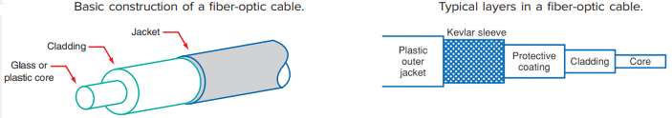
Fiber-Optic Cable Construction

Slide 11
CORE
The portion of a fiber-optic cable that carries the light is made from either glass or plastic. Another name for glass is silica.
The optical characteristics of glass are superior to those of plastic.
However, glass is far more expensive and more fragile than plastic.
Although plastic is less expensive and more flexible, its attenuation of light is greater. For a given intensity, light will travel a farther distance in glass than in plastic.

Slide 12
Cladding
The fiber, which is called the core, is usually surrounded by a protective cladding.
The cladding is also made of glass or plastic but has a lower index of refraction.
This ensures that the proper interface is achieved so that the light waves remain within the core.
In addition to protecting the fiber core from nicks and scratches, the cladding gives strength.
Some fiber-optic cable has a glass core with a glass cladding.
Other cables have a plastic core with a plastic cladding. Another arrangement, plastic-clad silica (PCS) cable, is a glass core with a plastic cladding.

Slide 13
Jacket
In addition to the core, its cladding, and a jacket, fiber-optic cable usually contains one or more elements to form a complete cable. The simplest cable is the core with its cladding surrounded by a protective jacket.
This jacket is made of some type of plastic, typically polyethylene, polyurethane, or polyvinyl chloride (PVC).
The main purpose of this outer jacket is to protect the core and cladding from damage.

Slide 14
Multi-Core Cable
The more complex cables may contain two or more fiber-optic elements. Typical cables are available with 2, 6, 12, 18, and 24 optical fiber cores.

Slide 15
Types of Fiber-Optic Cables
There are two basic ways of classifying fiber-optic cables:
The first method is by the index of refraction, which varies across the cross section of the cable.
The second method of classification is by mode, which refers to the various paths the light rays can take in passing through the fiber. Usually these two methods of classification are combined to define the types of cable.

Slide 16
According to Index of Refraction
Step Index Cable
Graded Index Cable.

Slide 17
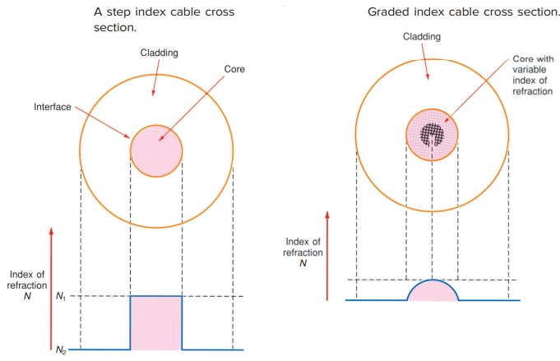

Slide 18
Step Index Cable
Step index refers to the fact that there is a sharply defined step in the index of refraction where the fiber core and the cladding interface.
It means that the core has one constant index of refraction N₁ and the cladding has another constant index of refraction N₂.
If you were to plot a curve showing the index of refraction as it varies vertically from left to right across the cross section of the cable, you would see a sharp increase in the index of refraction as the core is encountered and then a sharp decline in the index of refraction as the cladding is encountered.

Slide 19
Graded Index Cable
Here, the index of refraction of the core is not constant. Instead, it varies smoothly and continuously over the diameter of the core.
As you get closer to the center of the core, the index of refraction gradually increases, reaching a peak at the center and then declining as the other outer edge of the core is reached.
The index of refraction of the cladding is constant.

Slide 20
Cable Mode
Mode refers to the number of paths for the light rays in the cable.
There are two classifications:
Single mode and multimode.
In single mode, light follows a single path through the core; in multimode, the light takes many paths.
Each type of fiber-optic cable uses one of these methods of rating the index or mode.
In practice, there are three commonly used types of fiber-optic cable:
Multimode step index
Single-mode step index
Multimode graded index.

Slide 21
Multimode Step Index Cable
The most common and widely used type.
Easiest to make and the least expensive.
It is widely used for short to medium distances at relatively low pulse frequencies.
The main advantage of a multimode stepped index fiber is its large size.
Typical core diameters are in the 50- to 1000-μm range. Such large-diameter cores are excellent at gathering light and transmitting it efficiently.

Slide 22
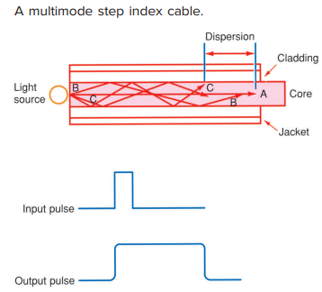

Slide 23
Dispersion
The light takes many hundreds or even thousands of paths through the core before exiting.
Because of the different lengths of these paths, some of the light rays take longer to reach the other end of the cable than do others. The problem with this is that it stretches the light pulses. This is called dispersion.
Dispersion is the distortion of the optical signal due to the characteristics of the cable.

Slide 24
Single-Mode Step Index Cable
A single-mode or monomode step index fiber cable essentially eliminates modal dispersion by making the core so small that the total number of modes or paths through the core is minimized.
Typical core sizes are 2 to 15 μm. The only path through the core is down the center. With minimum refraction, little pulse stretching occurs. The output pulse has essentially the same duration as the input pulse.

Slide 25
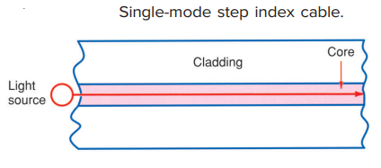

Slide 26
Advantages of Single-Mode Step Index Cable
Single-mode step index fi bers are by far the best because the pulse repetition rate can be high and the maximum amount of information can be carried.
For very long distance transmission and maximum information content, single-mode step index fiber cables should be used.

Slide 27
Disadvantages of Single-Mode Step Index Cable
The main problem with this type of cable is that it is extremely small, difficult to make, and therefore very expensive.
It is also more difficult to handle.

Slide 28
Multimode Graded Index Cable
Multimode graded index fiber cables have several modes, or paths, of transmission through the cable, but they are much more orderly and predictable.
Because of the continuously varying index of refraction across the core, the light rays are bent smoothly and repeatedly converge at points along the cable.
The light rays near the edge of the core take a longer path but travel faster because the index of refraction is lower.
All the modes or light paths tend to arrive at one point simultaneously. The result is less modal dispersion.
As a result, this cable can be used at very high pulse rates, and therefore a considerable amount of information can be carried.

Slide 29
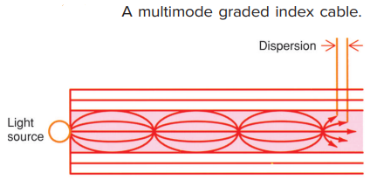

Slide 30
Multimode Graded Index Cable
This type of cable is also much wider in diameter, with core sizes in the 50- to 100- μm range.
Therefore, it is easier to splice and interconnect, and cheaper, less intense light sources can be used.

